Slide 1
Merging Two Salesforce.com Instances
Tad Travis, Customer Success Manager

Slide 2
Agenda
Presentation Goal
Systems Review
Process Review
Data Considerations
Migration Strategy
Tools and Resources

Slide 3
A Single Global Org Enables…
Greater Management Visibility
  Roll-Up Reporting
  Global drill-down into pipeline & activities
Standardized Processes
  Case Management
  Customer Life Cycle
  Opportunity Management
Collaboration
  Know what everyone everywhere is doing
  Maximize the corporate rolodex: Increase Upsell & Cross-Sell Productivity
  Avoid duplicate effort & conflicts within accounts
Global Standardization & Economies of Scale
  User Education
  Application Change Management
  Application Integration
  Managing Data Cleanliness
Regionally Personalized Configuration
  Granular security model, multiple profiles, records types, page layouts, sharing groups
  Translation Workbench

Slide 4
Presentation Goal
Provide recommended approach to merging two separate salesforce.com instances into one
Useful when:
  Standardize business processes
  Merge with/acquire another company that is also using salesforce.com
  Multiple instances exist within your company – i.e., different business units, different geographies
Note: This can be a complicated exercise, and it is recommended to
enlist assistance from an individual/team (i.e., Professional Services, Implementation Partner) with experience doing this.

Slide 5
Systems Review
Review processes enabled by the systems, and map the desired future state
  Opportunity, Case, Account Management
Review configuration of both systems, including:
  Tabs used (including Custom Tabs and Renamed Tabs)
  Custom Fields, Custom Links, sControls and Custom Buttons
  Custom Objects and relationships
  Pick List values
  Formula fields, Data (field) Validation Rules
  Email templates, mail merge templates
  Rules (Assignment, Workflow, Approvals, Field Updates)
  Profiles, Page Layouts, Search Layout
  Sharing Model → Role Hierarchy, Public Groups, Account Teams, and Sharing Rules
  Forecasting → Hierarchy, quotas, etc.
  Extended applications → PRM, AppSpace
  External integration points → Web to Lead, Web to Case, API version, APEX code
  Data model impacting features → Person Accounts, Territory Management

Slide 6
Systems Review
Identify all:
  similarities (overlaps),
  differences (gaps), and
  obsolete (unused/unnecessary) components
Determine which system will be the “master”
  Usually the one with more configuration, data and users
  The one with the preferable process(es)
  A new system with no interruption to either production org
Document potential implications as you perform this review for reference when you need to make adjustments
Identify a number of Test Plans based on real business scenarios – include all Tabs, Custom Objects, Custom Links, SControls, Reports, Dashboards, Roles, and Profiles for 360 coverage.

Slide 7
Consolidating Orgs: How to Begin?
(1) With a New, Empty Org
Pros
  opportunity to get it right
  don’t disrupt production usage
  selectively migrate the data that matters
Cons
  have to start from scratch
  Meta-data migration is manual (including Reports & Views)
  Some data can’t migrate
    system-generated fields (e.g. Create Date)
    Opportunity Stage History
    Case History
(2) Combine into an Existing Org
Pros
  Retain Higher %g of Data
Cons
  Disrupt Production Usage
    Security & Sharing Model
    Record Types
    Data migration
    Workflow Rules
    Assignment Rules
    Translation Workbench

Slide 8
Process Review
Remember that salesforce.com is configured to support your business processes
  Pick list values represent steps in a process (i.e., Opportunity Stage values = your sales process)
Involve individuals that represent both systems who:
  Knows the business(es) and understands the data,
  Knows why things are configured the way they are, and
  Can make decisions on what is critical information and what is not
Determine how you will address different processes
  Standardize on a single process (i.e., one set of sales stages)
  OR
  Implement separate processes for the different business/groups (i.e., multiple sales processes)

Slide 9
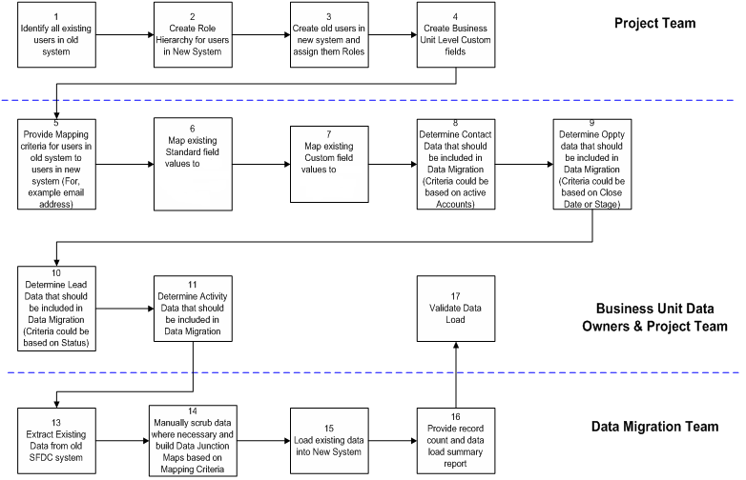
High-Level Process
new
new
template
template

Slide 10
Data Considerations
Addressing duplicate records
  There will most likely be overlapping/duplicate data
  Will need to be done either before or after you import the data from one system into the other
    Prior to importing into master account
      Export both data sets, merge into one and identify duplicates
      Merge/delete duplicates, import clean file
    After importing into master account
      Leverage de-dupe tools in salesforce.com
      Leverage de-dupe tools from partners (www.AppExchange.com)
      Use a custom field to flag each records source system
Develop rules for merging data
  When there are two records for the same entity (i.e., Account), which one ‘wins’?
    Newest record? Most complete record? Record from one of the databases? Most recently updated?
  Determine who will own the records if there are duplicates
    Impacts sharing rules, reporting, etc.
    Leverage for data cleansing that will ensue

Slide 11
Data Considerations
Establish plan for migrating data
  Determine when master system becomes live/system of record (i.e., stop entering data into other system)
  Set date when you will extract all data from the system being merged
  How long will the merge take? How will you deal with interim data? New data blackout dates? Temporary data ID?
  Ensure you have a complete copy of both data sets before attempting any merging … just in case!
  Note – if you have not done this type of work before, it is challenging.

Slide 12
Data Considerations
Create mapping tables
  Every record in salesforce.com is assigned a unique 18-digit alpha-numeric, case sensitive id by salesforce.com
  Relationships between records are established based on these IDs (i.e., Activity related to a Contact)
  These IDs will change when you import data from one system to another, as the system will assign it a new ID
  In order to re-create the relationships between records (i.e., import Activities and associate to the appropriate Contact), you need to create a mapping table that will allow you to associate the OLD Contact ID with the new one

Slide 13
Data Considerations
Create Mapping Tables (cont.)
  Create a temporary/mapping field on each object you will need to map for the old id (i.e., OLD ACCOUNT ID, LEGACY ID)
  Export all your data from the instance to be retired
    You can do this via the Weekly Export service, reports, the API, Excel Connector, AppExchange Data Loader or request a one-time full extract from customer support
    Don’t forget about attachments and Documents!
      Consider “dumping” these to a file server with a unique naming strategy and use Custom Links from the salesforce.com objects to access
  When importing the data into the master Account, map the Account Id to the OLD ACCOUNT ID field
  You will then be able to export the new Account Id, OLD ACCOUNT ID and Account Name to act as your mapping table

Slide 14
Data Considerations
Created Dates
  All records imported/migrated will have a Created Date = to when the import occurs
  To retain original dates, create a custom field to import into (i.e., Original Create Date)
  If you are updating via the API, the new 7.0 version will allow you to set the Created and Last Modified Dates: http://www.sforce.com/resources/tn-17.jsp
  Note: You must contact Salesforce support to enable this feature.
History Tables
  Stage History for Opportunities / Case History for Cases
  Data cannot be migrated into these tables, this information must be stored elsewhere if you bring it over (“Note” field is not Reportable, so custom field is recommended)
Unique Ids (system generated)
  Record Ids are unique and cannot be imported
  Imported records are assigned new Id, it is a good idea to import the old Id into a custom field for mapping purposes
  Features that reference (i.e., Custom Links) unique ids of other objects (i.e., a report) must also be updated

Slide 15
Data Considerations
Reports
  When reporting on migrated data, date filters must take into account standard and custom date fields (i.e., Create Date and Original Create Date)
  Other filters on existing reports must be reviewed to ensure they are still relevant/apply to all data
Record Types (Enterprise Edition only)
  If one of the salesforce.com instances leverages record types, all records added from the other instance must be assigned a Record Type
  Record Types can be updated through the API, not through the import wizard
  Record Type assignment must also be aligned with user Profiles

Slide 16
Data Considerations
What if data is inadvertently …
  Deleted
    Restore from the Recycle Bin (retained for 30 days)
    Restore missing data from backups
  Merged
    There is no way to “un-merge” data
    Clean up/work with merged records, OR
    Delete and restore from back ups
  Imported incorrectly
    Mass transfer (if you can)
    Delete and re-import into proper area
    Consider tagging batches with a custom field indicating the load/batch number in case you need to reverse

Slide 17
Migration Strategy
Establish project timeline, test plan, team and project sponsor
Determine changes that need to be made (configuration and procedural) and implement on master instance
  Add fields, pick list values, users, reports, etc.
  Data to be retired/archived and not merged
Communicate to end users upcoming changes, reasons, and benefits to them
Extract data from other instance and cleanse (merge)
  KEEP BACKUPS OF BOTH SYSTEMS

Slide 18
Migration Strategy
Import data into master instance
  Cleanse data prior to importing
Test/validate configuration changes and data
Re-train users on any changes
Sandbox Edition
salesforce.com now offers Sandbox Edition which is an exact duplicate of your production org (including data). Sandbox is ideal for testing and validating your Org-Merge process and procedures. Contact your AE for more information on Sandbox Edition pricing or get more information at:
http://www.salesforce.com/products/sandbox.jsp

Slide 19
General Issues to Remember
Inability to populate system generated dates
Inability to import into Opportunity Stage History & Case History
Reports and Views can not be migrated
Potential for duplicate data
Values for Contact, Sales Team and Account Team Roles will be global.
Maximum number of Workflow Rules

Slide 20
Tools and Resources
salesforce.com Functionality
  Exporting Data
    Reports, Weekly Export Service, One-time support extract
  Importing Data
    Import Wizards, Data Loader (Enterprise Edition)
  Cleansing Data
    Account/Contact/Lead Merge
  Sandbox Edition
    Full replication of production environment for testing purposes
Other Tools
  Excel Connector (both PE/EE, http://www.crmsuccess.com/browse/feature_detail.jsp?id=00630000002mUplAAE
  Data Loader (http://na1.salesforce.com/help/doc/en/data_loader.htm)
  Data loading/cleansing partner tools (DemandTools, Active Prime, Pervasive, etc.) http://www.salesforce.com/partners/solutions.jsp?id=Data%20Services/Data%20Quality
Assistance
  salesforce.com Professional Services
  Certified Partners

Slide 21
Recommended Update Order
Order | Object to Update | Related To
1 | Accounts
2 | Contacts | Accounts
3 | Opportunities | Accounts Contacts
4 | Products
5 | Product Line Items | Opportunities Products
6 | Cases | Contacts
7 | Leads
8 | Campaigns
9 | Campaign Members | Campaigns Contacts Leads
10 | Contracts | Accounts Contacts
11 | Assets | Accounts Contacts Cases Products
12 | Solutions | Cases
Depends | Custom Objects | Depends on implementation
Last | Activities | Can be to any standard or custom object

